Slide 1
Interpersonal Skills
The Sandbar Resort

Slide 2
Content
Interpersonal Skills
Organizational Context
Why Interpersonal Skills
Interpersonal Skills Model
10 Tips to Develop Interpersonal Skills

Slide 3
What is Interpersonal Skills?

Slide 4
What is Interpersonal Skills?
All about working with other people
An ability to get along with others while performing the job
Characteristic traits like Manners, attitude, courtesy, habits, behavior and appearance which helps us to communicate and maintain relationship with others

Slide 5
Organizational Context
The organizational context of how interpersonal skills are used can be shown by the vast number of interpersonal interactions

Slide 6
Interpersonal Skills While Working
Take the relationship viewpoint:
Effective relationships within the organization
Effective relationships with suppliers
Effective relationships with competitors

Slide 7
Interpersonal Skills While Working
Internally
In Teams
Across Teams
Within and between departments and business units

Slide 8
Interpersonal Skills While Working
Externally
With Suppliers
With Customers

Slide 9
Interpersonal Skills While Working
To gain real competitive advantage through such relationships in the long term is dependent upon your level of interpersonal skills

Slide 10
Why Interpersonal skills needed?
To Improve:
Relationship | Productivity
Working Environment | All Round Success
Leadership Skills | Liking by Others

Slide 11
Why Interpersonal skills needed?

Slide 12
Interpersonal Skills Model
Interpersonal Skills
Personality Development
Leadership Skills

Slide 13
When & Where Interpersonal Skills Are Required at Work Place ?
While working in groups to form effective teams
Socializing at work place
Presenting your self at work
Listening & Questioning
Giving or receiving feedback
Building & maintaining relationships

Slide 14
Tips To Improve Interpersonal Skills
Smile

Slide 15
Tips To Improve Interpersonal Skills
Be Appreciative

Slide 16
Tips To Improve Interpersonal Skills
Pay Attention

Slide 17
Tips To Improve Interpersonal Skills
Practice Active Listening

Slide 18
Tips To Improve Interpersonal Skills
Bring People Together

Slide 19
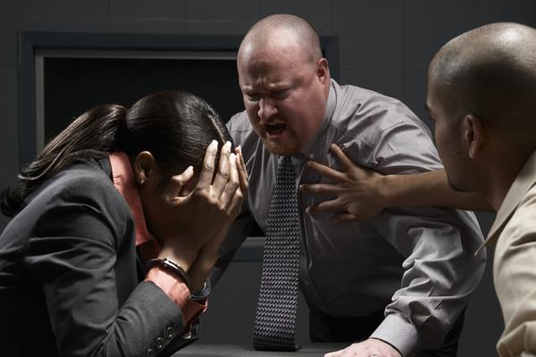
Tips To Improve Interpersonal Skills
Resolve Conflicts

Slide 20
Tips To Improve Interpersonal Skills
Communicate Clearly

Slide 21
Tips To Improve Interpersonal Skills
Humor Them

Slide 22
Tips To Improve Interpersonal Skills
Empathy/See It On Their Side

Slide 23
Tips To Improve Interpersonal Skills
Don’t Complain (Too much)

Slide 24
Conclusion
Interpersonal Skills
Organizational Context
Why Interpersonal Skills
Interpersonal Skills Model
10 Tips to Develop Interpersonal Skills
Notes:
kill

