Slide 1

13 Tips to Build Teamwork Skills
Notes:
See purchased photos

Slide 2
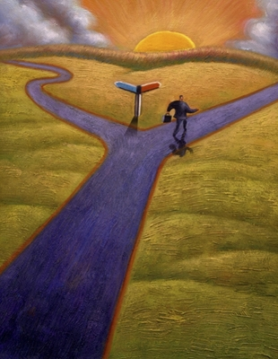
Know your goal
Strong teams pursue a unified vision, and align their actions with the project’s goal.
Make sure that you always know what your project’s goal is. Use this big picture to drive decision-making, and ride out conflicts and uncertainty.

Slide 3

Don’t make a habit of complaining
There’s always going to be something. Teams thrive in environments that focus on the positive (even in the face of chaos).
Complaining can be like a small leak—if it grows, it can take the whole ship down.

Slide 4

Be solution focused
Everyone’s a critic. That’s easy. Giving constructive feedback is a skill—and a necessary part of project and career success.
Provide your two cents by offering an idea or a solution. Then anything can happen!

Slide 5

Use your time wisely
How you use your time and manage your work impacts your entire team, the project and your organization.
Be diligent about developing ace time management skills. Find habits that are realistic and fit your personality.

Slide 6

Listen up
Listening is good for everyone. It makes team members feel valuable, provides learning opportunities, and minimizes misunderstandings.
Take your skills up a notch and be an active listener.

Slide 7

Respect other people’s ideas
Even if you think someone’s idea is ridiculous, dismissing it could shut the door on any number of fruitful conversations and project initiatives.
Ingenious teams have an open-door policy for ideas.

Slide 8

Be an avid communicator
The benefits of clear communication in the workplace include increased productivity, higher morale and improved retention.
P.S. 70% of people forget what they hear. Be a consistent communicator.

Slide 9

Acknowledge and appreciate
Acknowledgement gives team members the boost they need to sustain enthusiasm and curiosity over time. Some easy ways to show appreciation:
Verbalize it.
Listen.
Ask questions.
Provide opportunity.

Slide 10

Share your enthusiasm
Moods are infectious. If you feel passionate about a project, initiative or idea, go to the mountain top!
This will rally your team members and get them excited about what they’re doing (or, push them to do work they really care about).

Slide 11

Don’t say anything in email you wouldn’t say in person
Email and chat systems are great—but use these as delivery systems for information and data only.
When interpersonal wires get crossed; when challenging or sensitive news needs to be delivered, have an in-person conversation. Know when to bring your humanity to a situation.

Slide 12

Have courage
Courage is the prerequisite for:
Honesty
Transparency
Integrity
Embracing uncertainty
Taking risks
Making tough decisions
“Courage was not the absence of fear, but the triumph over it.” –Nelson Mandela

Slide 13

Celebrate achievements
It’s important to acknowledge the jobs well-done.
Whether it’s a five-second high-five or a celebratory team lunch, make sure the winning milestones get recognized. The team will stay motivated for the next round!

Slide 14

Have a sense of humor
Humor helps us keep a sense of perspective, is a great bonding tool, and adds a necessary element of play that feeds our souls.
Plus, when you’re having fun you’re more relaxed and that leads to greater creativity and a happy team!

