Slide 1
Psych 638: Training needs assessment
Dr. Stephen Zaccaro
George Mason University

Slide 2
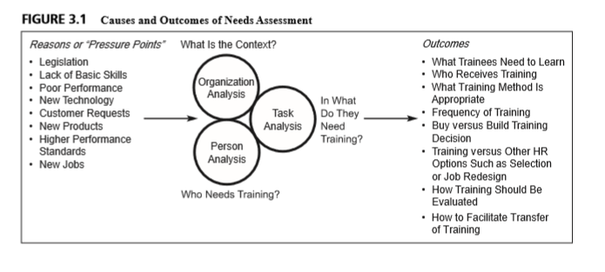
Introduction to Training Needs Assessment (TNA)
Three main components
Organization analysis
Task analysis
Person analysis
What are some causes and outcomes of a TNA
Notes:
Source of Figures and tables: Noe, 201

Slide 3
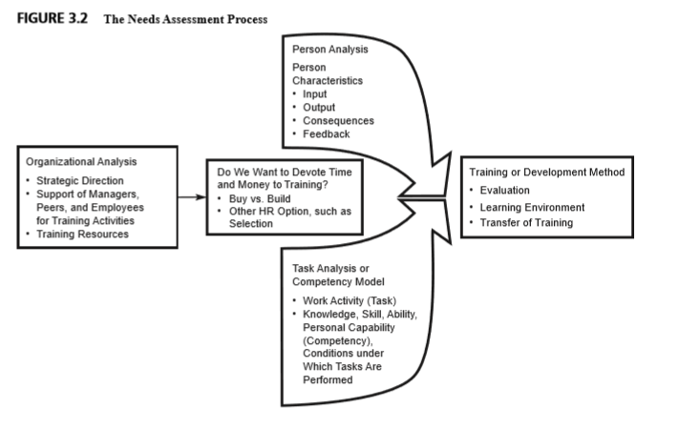
Needs Assessment Process

Slide 4
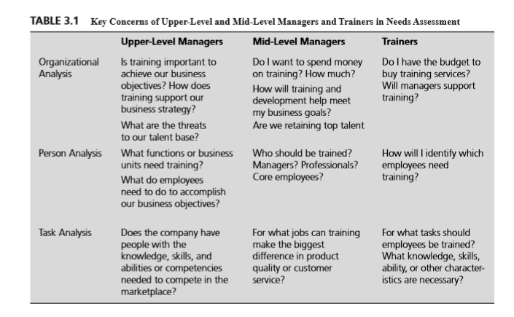

Slide 5
Why a Training Needs Assessment?
Performance problems may not be a function of trainable skills and processes – training becomes a waste of resources
Without a TNSA, training may target the wrong KSAOs (e..g, fad-driven training)
Trainees may not have the readiness for training, something that is uncovered in the person analysis of a TNA
The designed program may not match or yield outcomes expected the company
The training program is not connected to business strategy, again wasting company resources

Slide 6
Components of a TNA
Organizational Support Analysis
Key goals
Establishing support with management
Ensuring that process will deliver required outcomes
Themes
Is there support for conducting a confidential TNA
What can the company provide in terms of support, time, and effort
Who will be the POC and support person(s) for the TNA
How can the TNA be conducted to minimize the “footprint” in operations?
Who should be the key participants in the TNA, and will the company support their participation?
What methods will be used to collect data, and how will such data collection occur?
Focus groups
What does management expect by way of TNA outcomes?
Do they want results of the TNA process?
Assurances of confidentiality of data and results

Slide 7
Components of a TNA
Organizational Analysis (focus groups)
Key goals
Assess the context for training – the training climate?
Determine overall organizational strategic goals, and the goals for training
Themes
What is the general strategic direction and goals of the company?
How does development fit into business strategy?
What are the developmental resources available?
How will development be supported?
What are the constraints to development?
Internal constraints?
External constraints (legal, regulatory, unions, etc)?

Slide 8
Components of a TNA
Task Analysis
Key goal
Establishing key task performance requirements
Establishing required KSAOs and competency models
Themes
What are the tasks that compose target job categories?
What are the frequencies, importance, and difficulty levels of each task?
What are the knowledge, skills, abilities, and other attributes necessary to complete task requirements?
See page 136 in Noe (2013): Steps in a task analysis
See Tables 3.7 and 3.8

Slide 9
Components of a TNA
Person Analysis
Key goals
Determine levels of necessary KSAOs in current target employees
Determine developmental readiness of current target employees
Themes
Who needs training
What are current levels of targeted KSAOs
What are the developmental readiness levels of potential trainees
Ability to complete training
Motivation to complete training
What is the context of work, in terms of input, outputs, consequences and feedback that influence worker performance (See Figure 3.3 in Noe, 2013)
Is training the best solution?

Slide 10
Methods used in a TNA
Observation
Questionnaires
Interviews
Focus groups
Archival materials
Job documentation
Historical work data (performance appraisals, absenteeism records)
Automated (electronic) surveillance and recording
“this call may be monitored for training purposes
See Table 2.2 in Noe (2013) for advantages and disadvantages for each one

Slide 11
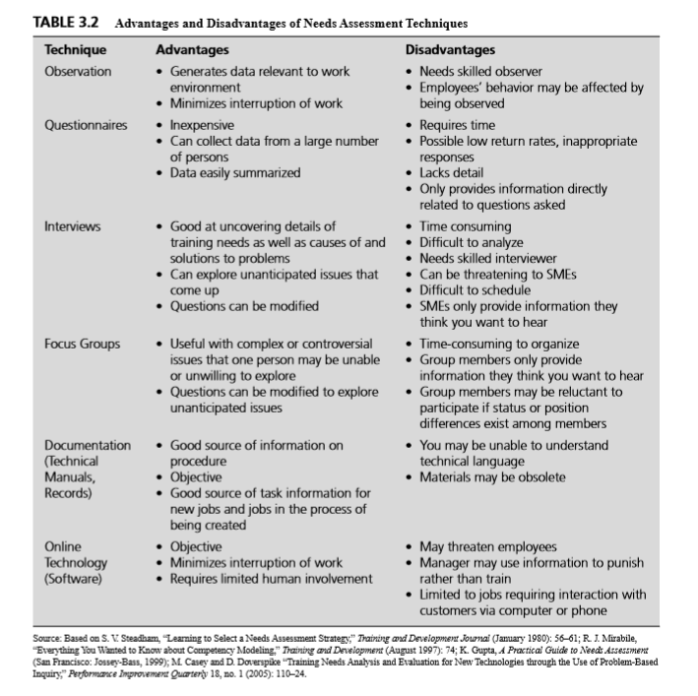

Slide 12
Enhancing Transfer of Training
Have a system that unites trainer, trainee, and manager in the transfer process
Before training, the expectations for the trainee and the manager must be clear
Identify obstacles to transfer and provide strategies to overcome these problems
Work with managers to provide opportunities for the maintenance of trainees’ learned behavior in work organizations
Develop a continuous learning climate so that an atmosphere emerges where employees feel it is important to continually learn and develop. This probably includes support for situations where formal training may not even exist.
Notes:
People who participate in training are often faced with a problem: they are required to learn something in one environment (training situation) and use the learning in another environment (on the job).
Goldstein & Ford (2002)

Slide 13
Why Evaluate a Training Program?
1. To identify the program’s strengths and weaknesses. This includes determining if the program is meeting the learning objectives, if the quality of the learning environment is satisfactory, and if transfer of training to the job is occurring
2. To assess whether the content, organization, and administration of the program— including the schedule, accommodations, trainers, and materials—contribute to learning and the use of training content on the job.
3. To identify which trainees benefit most or least from the program.
4. To assist in marketing programs through the collection of information from participants about whether they would recommend the program to others, why they attended the program, and their level of satisfaction with the program.
5. To determine the financial benefits and costs of the program.
6. To compare the costs and benefits of training versus nontraining investments (such as work redesign or a better employee selection system).
7. To compare the costs and benefits of different training programs to choose the best program

Slide 14
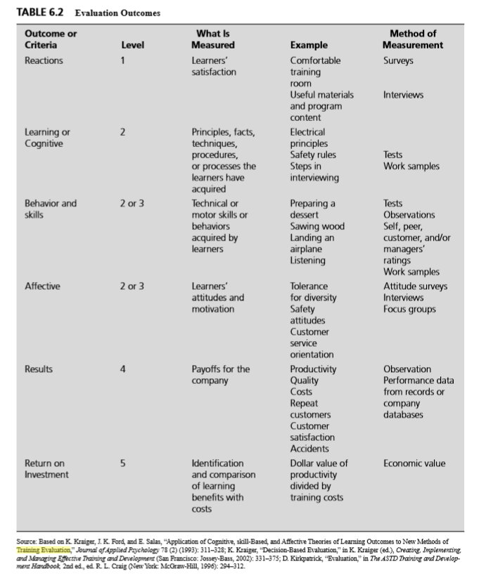
Training Evaluation

